Slide 1
PRESENTED BY : R.SUBHASHINI
REG NO : 813821205051
DEPT : INFORMATION TECHNOLOGY
COLLEGE : SARANATHAN COLLEGE OF ENGINEERING
NM ID: subhaabi2k04@gmail.com
(au813821205051)
Predictive Modeling for Gender and Age
Identification using Keras and TensorFlow.
3/21/2024 Annual Review

Slide 2
PROJECT TITLE
Predictive Modeling for Gender and Age
Identification using Keras and TensorFlow.
3/21/2024 Annual Review

Slide 3


AGENDA
❖PROBLEM STATEMENT
❖PROJECT OVERVIEW
❖WHO ARE THE END USERS?
❖YOUR SOLUTION AND ITS VALUE PROPOSITION
❖THE WOW IN YOUR SOLUTION
❖MODELLING
❖RESULTS
3/21/2024 Annual Review

Slide 4

PROBLEM STATEMENT
Develop a machine learning model using Keras and TensorFlow to predict the gender and age of individuals based on given input data. The model should take into account various features such as facial images, textual data, or any other relevant information that can contribute to accurate predictions. The goal is to create a robust and efficient model capable of accurately identifying the gender and age group of individuals from diverse backgrounds and demographics.
3/21/2024 Annual Review

Slide 5

PROJECT OVERVIEW
This project aims to develop a computer program using Keras with TensorFlow that predicts the gender and approximate age of individuals from their photos. By leveraging advanced machine learning techniques, the program analyzes patterns in images to make educated guesses. This capability has practical applications in targeted advertising, demographic analysis, and entertainment.
3/21/2024 Annual Review

Slide 6

WHO ARE THE END USERS?
Researchers
Marketing Professionals
Social Media Platforms
Entertainment Industry
Healthcare Professionals
Developers
General Users
3/21/2024 Annual Review

Slide 7
YOUR SOLUTION AND ITS VALUE PROPOSITION
Solution:
The solution for age and gender prediction using deep learning involves developing a neural network model trained on a dataset containing images labeled with both age and gender information. The model architecture could be a convolutional neural network (CNN) or a combination of CNN and recurrent neural network (RNN) layers depending on the complexity of the task.
Value Proposition:
Accurate Predictions
Diverse Data Handling
Robustness and Efficiency
Applications in Multiple Fields – Retail,Healthcare,Entertainment
Exploration of Deep Learning Techniques
3/21/2024 Annual Review

Slide 8
THE WOW IN YOUR SOLUTION
Multi-Modal Approach : By incorporating various features such as facial images and textual data, the model utilizes a multi-modal approach to enhance prediction accuracy.
Advanced Deep Learning Techniques : The project explores deep learning architectures such as convolutional neural networks (CNNs) for image processing and recurrent neural networks (RNNs) for textual data analysis.
Real-World Applications : The ability to accurately predict gender and age has significant real-world applications in demographics analysis, targeted advertising, personalized services, and beyond.
Robustness and Efficiency : The developed model is designed to be robust and efficient, capable of handling diverse input data and delivering accurate predictions in real-time or near-real-time scenarios.
Potential for Innovation : By pushing the boundaries of deep learning techniques in gender and age prediction,It paves the way for future research and development efforts aimed at refining predictive models and exploring new applications in demographics analysis and beyond.
3/21/2024 Annual Review
‹#›

Slide 9
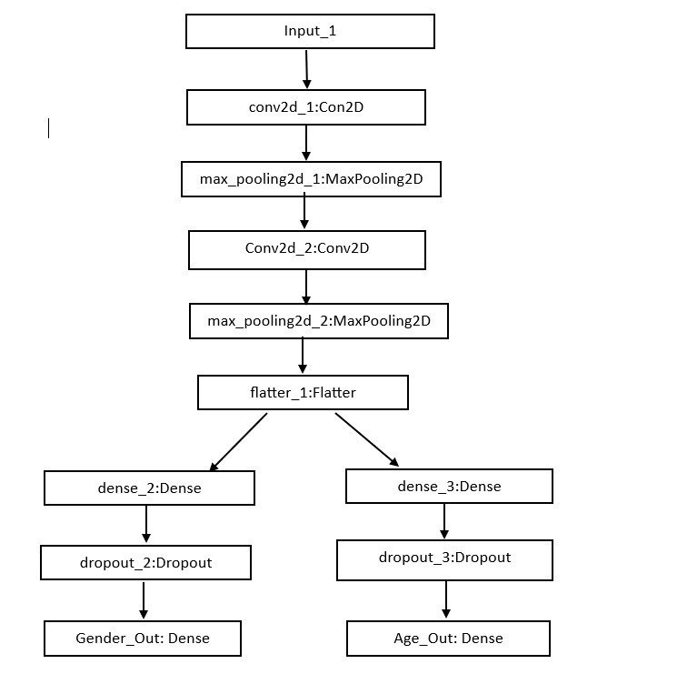
MODELLING
3/21/2024 Annual Review
‹#›

Slide 10
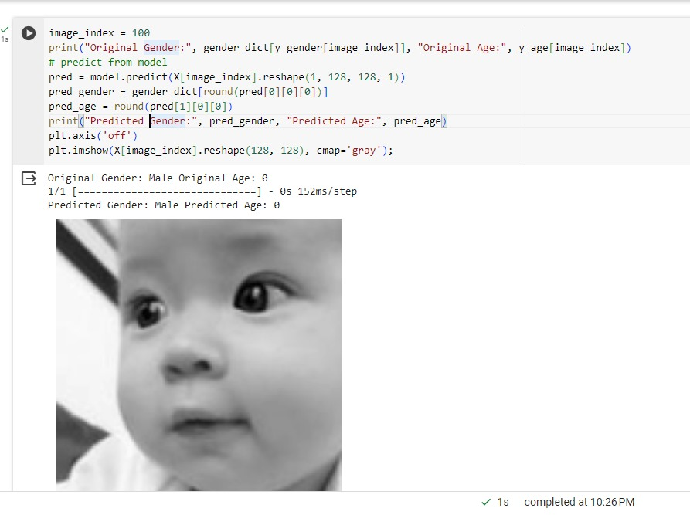
RESULTS
This project utilizes Convolutional Neural Networks (CNNs) to analyze patterns and features in images for predicting the gender and approximate age of individuals depicted in photos. While the model's predictions aren't guaranteed to be entirely accurate, they offer valuable insights for applications like targeted advertising, demographic analysis, and entertainment.
https://github.com/SubashiniRamesh/TNSDC-Generative-AI
3/21/2024 Annual Review
‹#›

